Slide 1
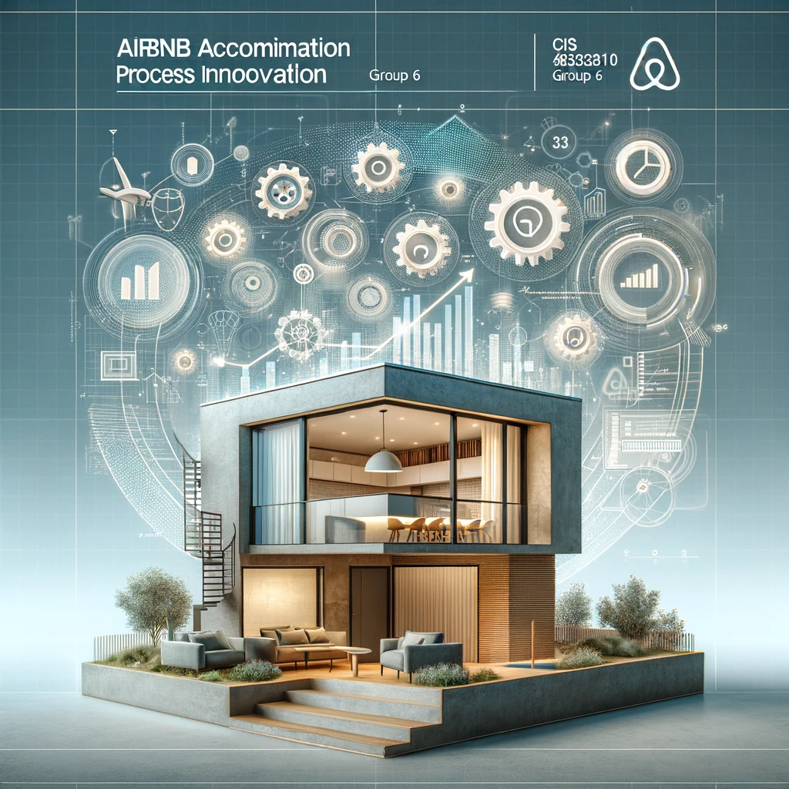

AIRBNB ACCOMODATION
CIS 8010: Process Innovation
Group 6​
Project Milestone 4
Anitta Varghese
Md Kamruzzaman Kamrul
Ritesh Sengar
Bach Hong

Slide 2
STEP 5: CREATE A FUTURE STATE JOB SERVICE MODEL a. Create a future state job service model that delineates how the service would work after your proposed VLIFT strategies are implemented (hypothetical). Show how the future state meets the CVM targets from the earlier step
Aim: Illustrate how the service transforms post-VLIFT strategies, meeting CVM targets.
Focus areas:
- Calendar Synchronization
- Pricing Transparency
- Verification Process Efficiency
- Instant Booking Response Rate

Slide 3
Future State:
Automated verification process using AI, ML.
Verification within hours, benefiting frequent users with streamlined re-verification.
CVM Target Achievement:
Average verification time < 24 hours, enhancing user convenience.
Verification Process Efficiency

Slide 4
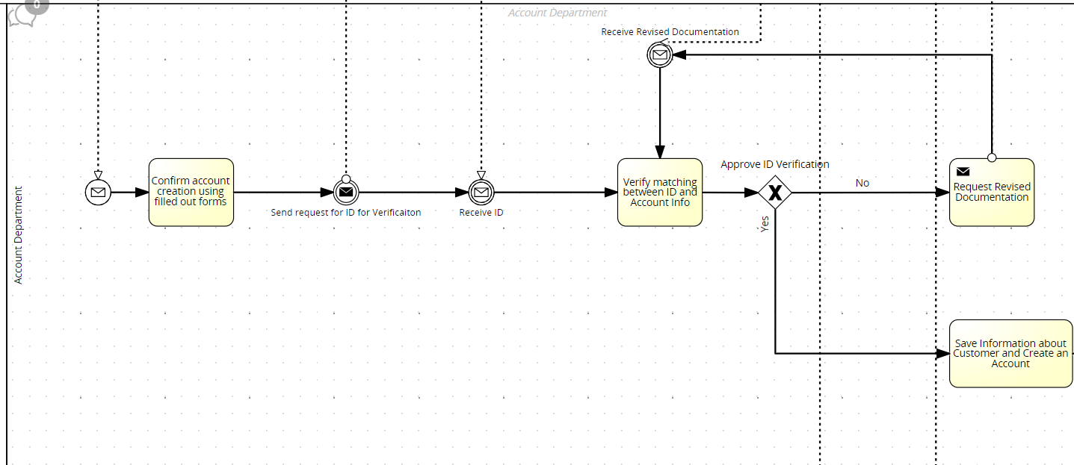
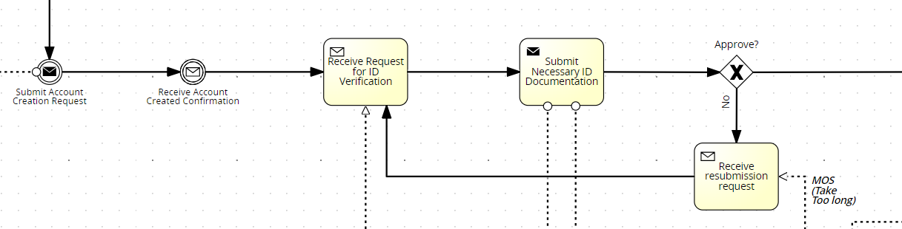
Before
Service Provider
Customer

Slide 5
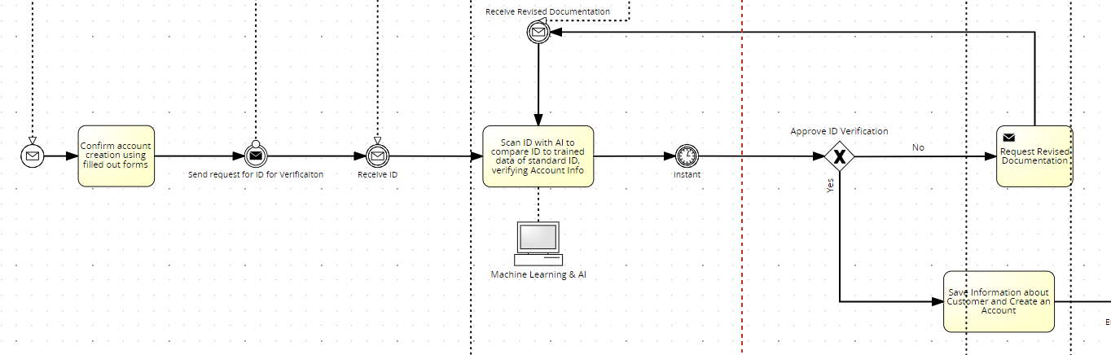
After
SP

Slide 6
Calendar Synchronization
Future State:
Seamless, automated synchronization with > 98% accuracy.
Real-time updates and alerts with major calendar platform integration.
CVM Target Achievement:
95% accuracy, reducing re-searching time and improving booking confidence.

Slide 7
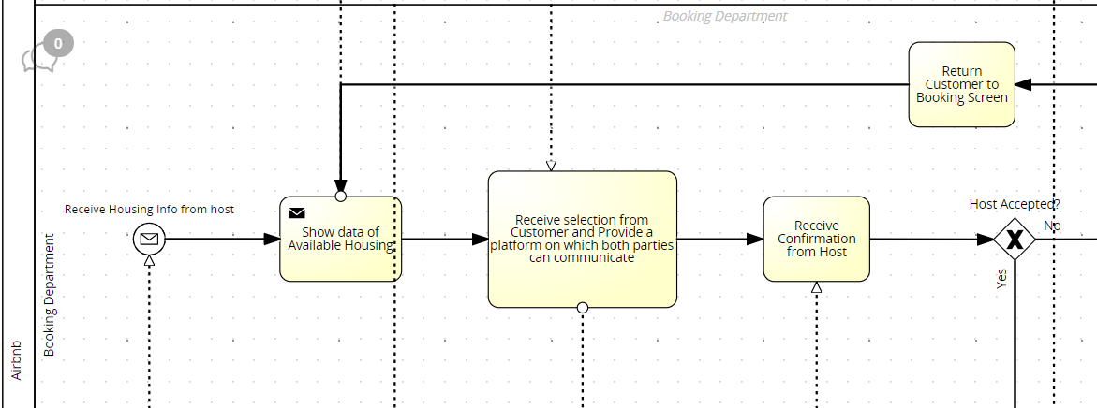
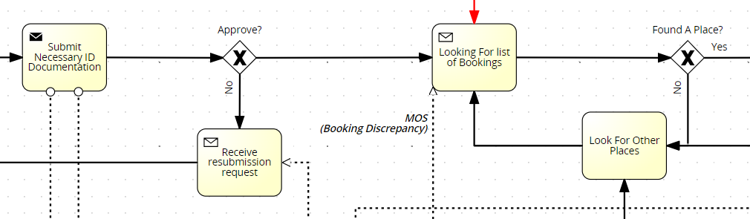
Before
Service Provider
Customer

Slide 8
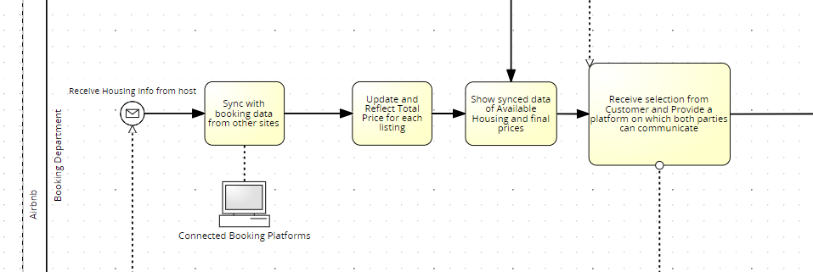
After
Service Provider

Slide 9
Instant Booking Response Rate
Future State:
Instant booking for > 85% services with real-time integration.
Intelligent resource prioritization during peak times.
CVM Target Achievement:
≥ 80% bookings confirmed instantly, reducing uncertainty.

Slide 10
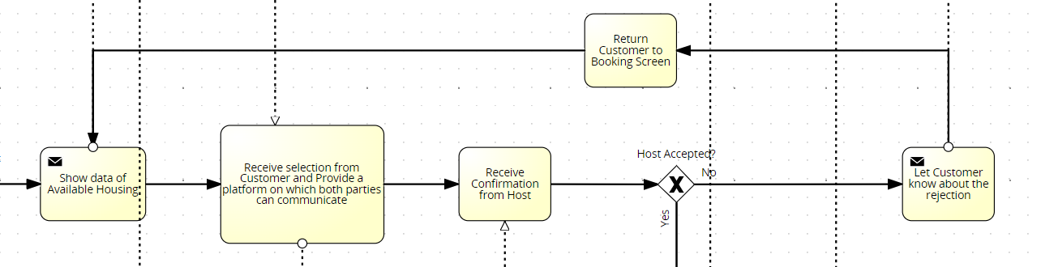
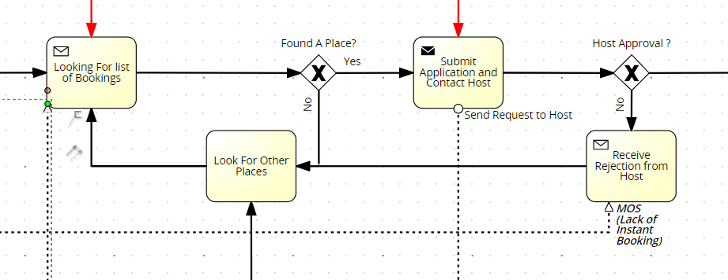
Service Provider
Before
Customer

Slide 11
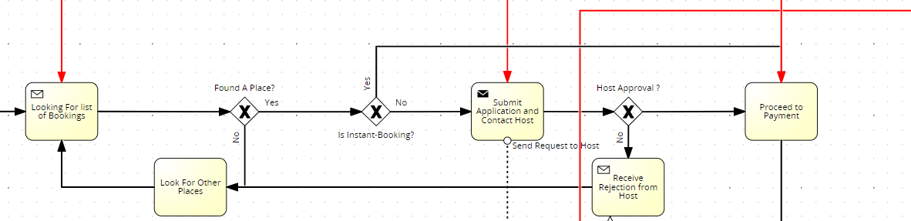
After
Customer

Slide 12
Pricing Transparency
Future State:
Dynamically updated, transparent pricing with < 5% variance.
Real-time calculators and clear breakdowns provided upfront.
CVM Target Achievement:
< 10% variance between listed and final prices.

Slide 13
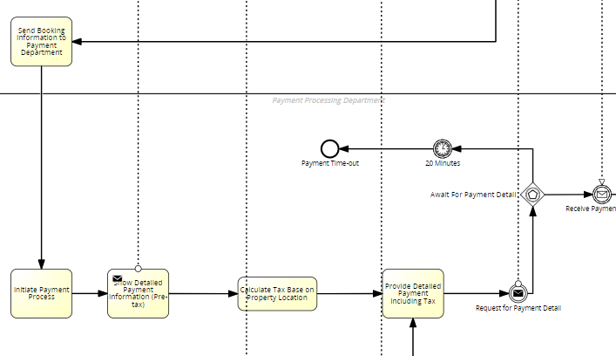
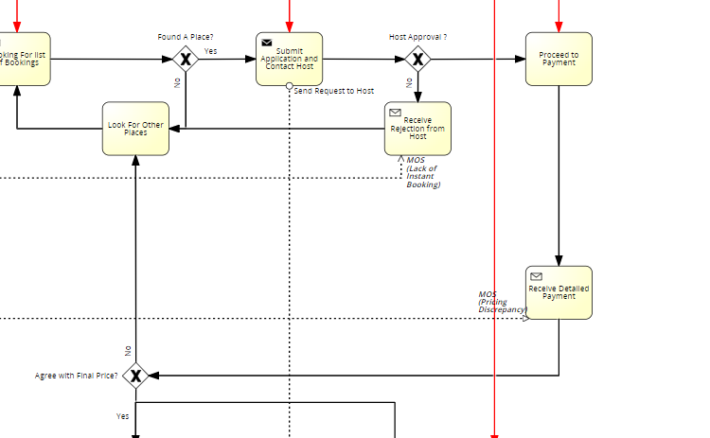
Service Provider
Before
Customer

Slide 14
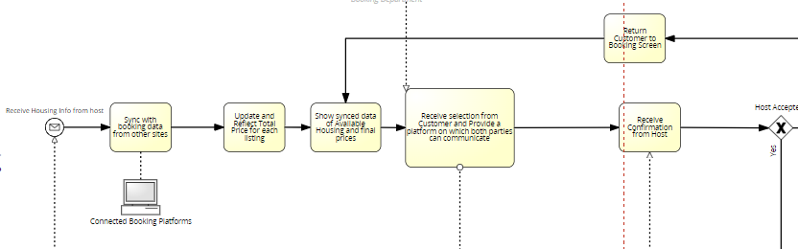
Before
Service Provider

Slide 15
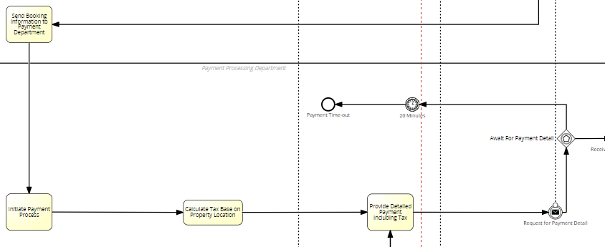
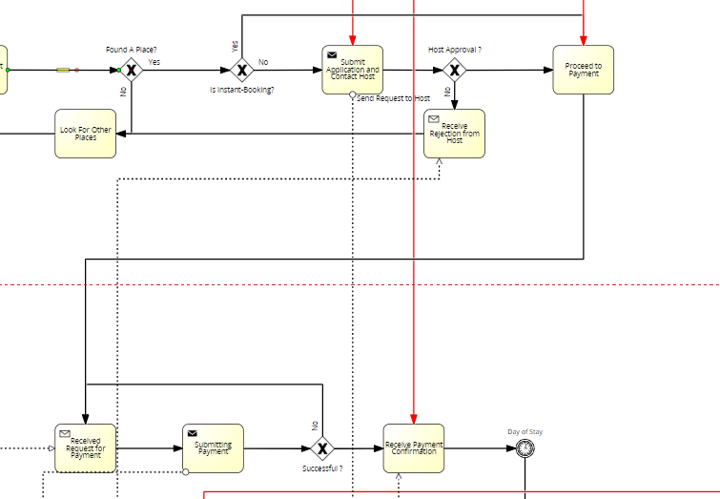
After
Service Provider
Customer

Slide 16
Operational Model
Integration of Technology and Automation:
Advanced tech and automation for speed, accuracy, reliability.
Tailored Customer Experience:
Customized services for different segments.
Process Optimization:
Lean and Six Sigma for efficiency, lower cost.
Dynamic Adaptation:
Continuous improvement based on feedback, analytics.

Slide 17

Cost Structure and Pricing
Transformative Vision:
Precision, efficiency, personalization for customer needs.
Achievements through VLIFT:
Enhanced satisfaction, trust, competitive advantage.

Slide 18
Concluding Remarks: Achievement & Comparison
Customer-Centric Excellence: VLIFT strategies drive customer satisfaction.
Operational Efficiency: Technology and automation enhance operations.
Empowered Trust: Transparency and personalization build customer loyalty.
Future Vision: Commitment to continuous improvement for sustained growth.
Before VLIFT Implementation:
Longer verification process (>24 hours).
Calendar synchronization with frequent discrepancies.
Limited instant booking availability (<50%).
Pricing transparency with >15% variance.
Manual processes prone to errors and delays.
After VLIFT Implementation:
Verification process streamlined (<24 hours).
Highly accurate calendar synchronization (>98% accuracy).
Increased instant booking availability (>85%).
Enhanced pricing transparency (<5% variance).
Automated processes reducing errors and improving efficiency.

